Slide 1
Breadth First Search (BFS)
Navilur Rahman Talukder ID: 0242310005103002

Slide 2
What Is Breadth Frist Search (BFS)?
Breadth-first search (BFS) is an algorithm for traversing or searching Tree or Graph data structures.
It Starts at the tree root or some arbitrary node of a graph, somethings referred to as a ‘search key’ and explores all of the neighbor nodes at the present depth prior to moving on to the nodes at the next depth level.

Slide 3
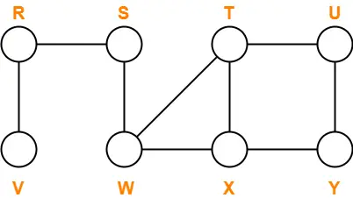
Traverse the following graph using Breadth First Search Technique

Slide 4
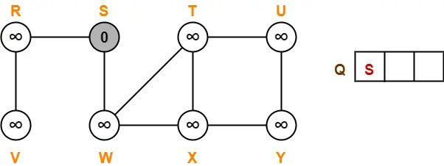
Step1

Slide 5
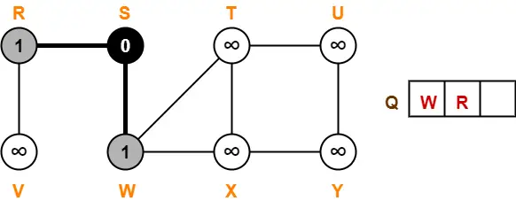
Step2

Slide 6
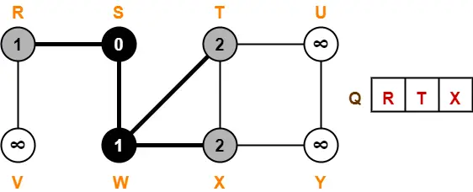
Step3

Slide 7
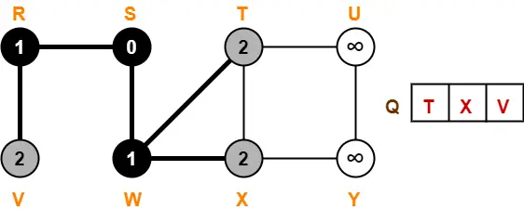
Step4

Slide 8
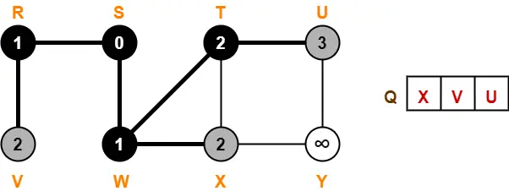
Step5

Slide 9
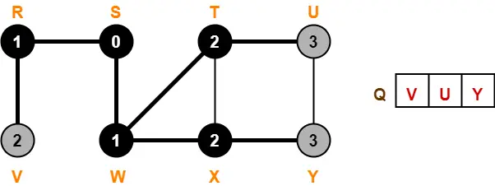
Step6

Slide 10
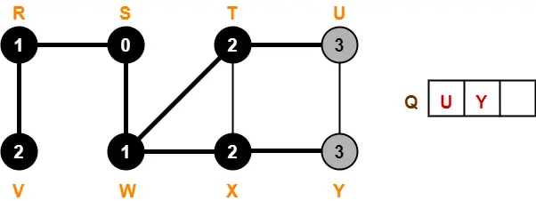
Step7

Slide 11
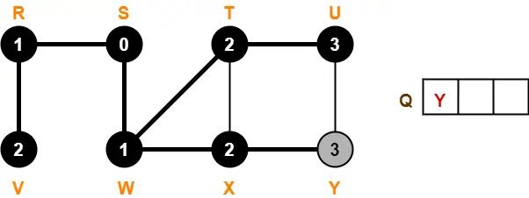
Step8

Slide 12
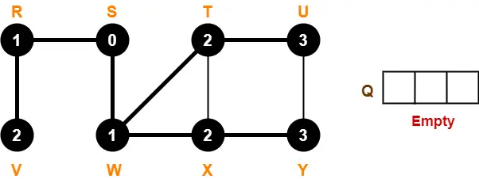
Step9

Slide 13
Applications of Breadth First Search
There are many applications Breadth First Search.
GPS Navigation systems: Breadth First Search is used to find all neighboring locations. Navigation system such as Google Maps, which can give direction to reach from one place to another use BFS.
Peer to Peer Networks: In Peer to Peer Networks like BitTorrent, BFS is used to find all neighbor nodes.
Broadcasting in Network: In networks, a broadcasted packet follows BFS to reach all nodes.
Social Network Websites: In social networks, we can find people within a given distance ‘k’ from a person using Breadth First Search till ‘k’ levels.
In Garbage Collection: BFS is used to copying garbage collection.

Slide 14
Time and Space Complexity
The time complexity of BFS is, O(V + E)
Where V is the number of nodes and E is the number of edges.
The space complexity can be expressed as, O(V)
Where V is the cardinality of the set of vertices.

Slide 15
Thank You

